Slide 1
CELLML MODULAR SYSTEMS BIOLOGY
3-File MAPK Architecture & Kinetic Curve Analysis
Component import hierarchy, PI3K/Akt isolation proof, and mathematical causes of S-shaped vs. bell-shaped ERKPP dynamics

Slide 2
OPENCOR TUTORIAL FIG. 28 & FIG. 32 CONVENTION
Overall Structure of the 3-File CellML Hierarchy
Imports
Units
Encapsulation
Components
Mappings
File 2: HATAKEYAMA_noAKT.cellml
File 1: HATAKEYAMA_EDITED
File 3: Full_MAPK_Model.cellml
Encapsulation Group: Hatakeyama_MAPK_Cascade
Imports
Units (s, nM)
EXPORTED TO FILE 2:
Akt_PIP_zero = 0 | Akt_PIPP_zero = 0 {priv: out}
• RasGDPtoRasGTP
environment — t: {pub: out}
• RAF & MEK & ERK
Import
Import
Mappings: t, S2D_pDAP10_GS, RasGTP, RAF_star, MEKPP, ERKPP
RasGDPtoRasGTP
ShGS -> RasGTP
UNIMPORTED SIBLINGS (CUT OFF):
1 Capsule
4 Kinases
✕ comp PI3K (Excluded)
S1_NKG2D
cytokine
RAF
RasGTP -> RAF_star
S2D_pDAP10_GS {pub: out}
Hatakeyama_MAPK
ERKPP -> TNF {pub: out}
✕ comp Akt (Excluded)
Imported Capsule
MEK
RAF_star -> MEKPP
✕ File 1 environment
ERK
MEKPP -> ERKPP

Slide 3
FILE 1: BASELINE LITERATURE MODEL
Curated Hatakeyama Model Structure
Standalone Execution: Includes environment clock and closed inputs.
comp PI3K (ErbB4 + HRG = 333 nM)
Bifurcated Receptor: HRG activates both ShGS and PI3Kstar.
Akt Cross-Talk: Akt_PIPP accelerates RAF_star dephosphorylation.
comp Akt
Ras -> RAF -> MEK -> ERK
Inhibits RAF & sequesters PP2A
PP2A Competition: Akt_PIP and Akt_PIPP compete with MEK.
Exported to File 2 via import

Slide 4
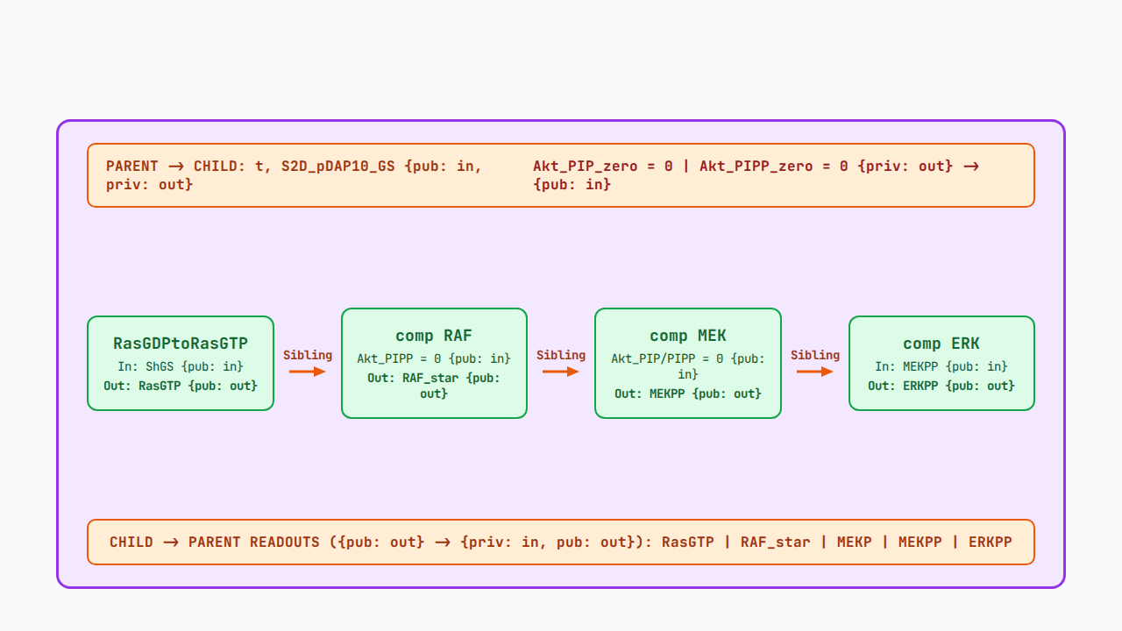
FILE 2: OPENCOR TUTORIAL FIG. 22 INTERFACE HIERARCHY
Parent–Child ({priv} to {pub}) & Sibling ({pub} to {pub}) Ports

Slide 5
OPENCOR COMPILATION BEHAVIOR
Why File 2 Shows "Under-Constrained" Alone
File 2 Opened Standalone
Files 1 & 3 Opened in OpenCOR
Role: Pure reusable middleware submodel library.
Role: Complete top-level executable simulation models.
Open Time Port: Expects var t: s {pub: in} from parent.
Closed Time: Contains def comp environment generating t.
Open Signal Port: Expects S2D_pDAP10_GS {pub: in} from parent.
Closed Signal: S1_NKG2D supplies S2D_pDAP10_GS to File 2.
Expected Status: Unconstrained until imported by File 3.
Expected Status: Compiles and integrates cleanly in OpenCOR.

Slide 6


FILE 3: EXECUTABLE NK CELL MODEL
Signal Routing Across Full_MAPK_Model
1. S1_NKG2D Receptor
2. Imported MAPK Capsule
3. Cytokine & Readouts
Generates active S2D_pDAP10_GS adapter complex upon ligand binding.
Maps S2D_pDAP10_GS into ShGS to trigger Ras-RAF-MEK-ERK.
Collects RasGTP, RAF_star, MEKPP, and ERKPP to drive TNF.

Slide 7
PART 2: PATHWAY ISOLATION & KINETIC SHAPE
Why PI3K/Akt Cannot Interfere & Why ERKPP Forms an S-Curve

Slide 8
QUESTION 2 ANSWERED: ZERO INTERFERENCE
Mathematical Proof of PI3K & Akt Exclusion
Component | Status in Files 2 & 3 | Evaluated Term in File 3 | Interference
comp PI3K | Not imported from File 1 | 17 ODEs excluded | 0% (Absent)
comp Akt | Not imported from File 1 | 6 ODEs excluded | 0% (Absent)
comp RAF (v14) | Akt_PIPP locked to 0 nM | kf14 * (0 + E) * RAF_star | 0% (Basal E only)
comp MEK (v16/18) | Akt_PIP & Akt_PIPP = 0 nM | 0/k31 + 0/k33 = 0 | 0% (No PP2A loss)

Slide 9
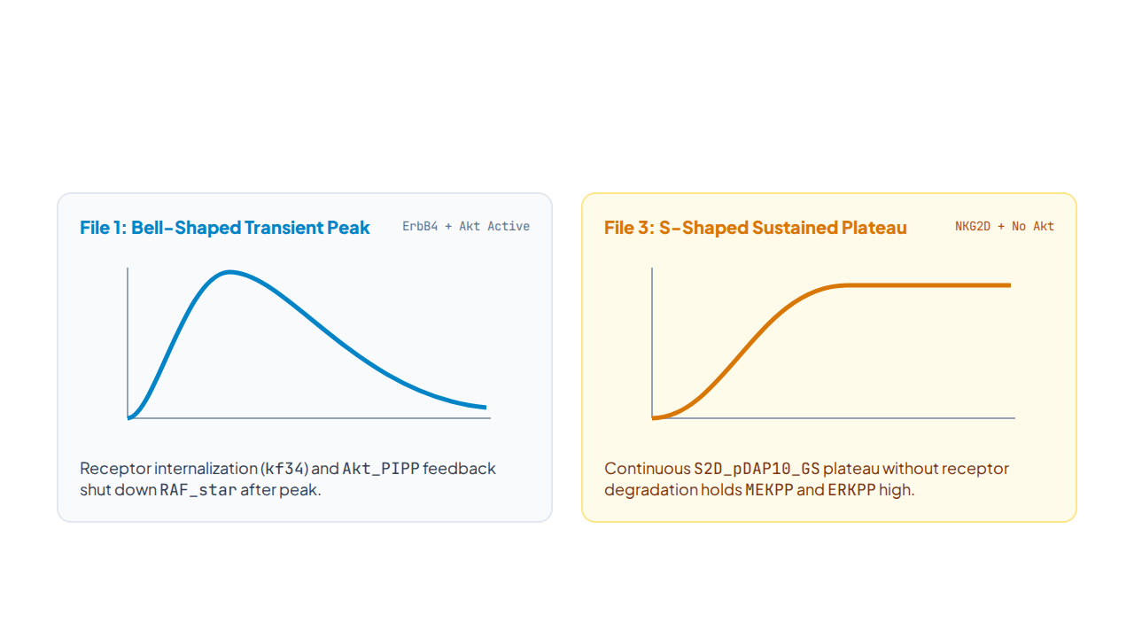
QUESTION 1 ANSWERED: WAVEFORM COMPARISON
Why File 1 Peaks & Decays While File 3 Plateaus

Slide 10
MECHANISTIC BREAKDOWN
Three Causes of the S-Shaped Plateau
01 / RECEPTOR SINK
02 / ADAPTER DECAY
03 / RAF FEEDBACK
No Receptor Internalization
Sustained Adapter Input
Zero Akt Inhibition
S2D_pDAP10_GS reaches steady equilibrium.
RAF_star avoids Akt_PIPP deactivation.
S1_NKG2D lacks receptor degradation.

Slide 11
QUANTITATIVE PARAMETER COMPARISON
Rate Constants Governing Curve Shape
0.00015
40.8 s⁻¹
8e-5 s⁻¹
7.0 nM
File 1 Internalization (kf34)
File 1 ShGS Decay (kf9)
File 3 CD45 Rate (k_f6)
File 3 RAF Phosphatase (E)
Depletes active ErbB4 receptor pool over time.
Rapidly dissociates ShGS into ShP and GS.
Slow dephosphorylation preserves active pDAP10.
Constant basal rate without Akt_PIPP surge.

Slide 12
OPENCOR TUTORIAL BEST-PRACTICE VERIFICATION
Alignment with OpenCOR Tutorial Sections 8–11
SECTION 10 (PAGE 25)
SECTION 9 (FIG. 22, PAGE 20)
Selective Sibling Exclusion
Parent–Child–Sibling Ports
Importing 4 MAPK components automatically excludes PI3K.
Wrapper uses private interfaces to encapsulate sibling kinases.
SECTION 11 (FIG. 32, PAGE 30)
SECTION 11 (PAGE 33)
Pure Submodel Architecture
One-Click CellML 1.0 Flattening
File 2 omits local environment like Noble62 channel files.
Export single file via Tools -> CellML File Export To.

Slide 13
MODELING CONCLUSIONS
Clean Modular Isolation & Sustained NK Signaling
Simulate Full_MAPK_Model.cellml (File 3) for your integrated NK pathway and HATAKEYAMA_JON_EDITED.cellml (File 1) for literature validation.

